Slide 1
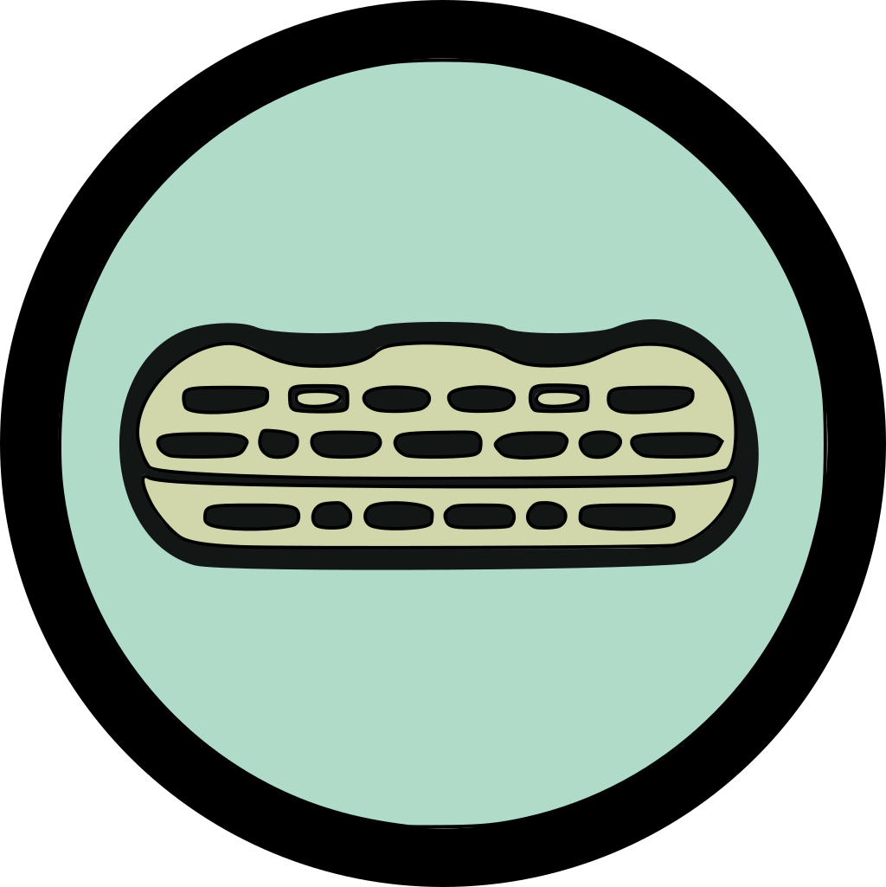
Zlag Track
Track the progress of your zlagboard training

Slide 2
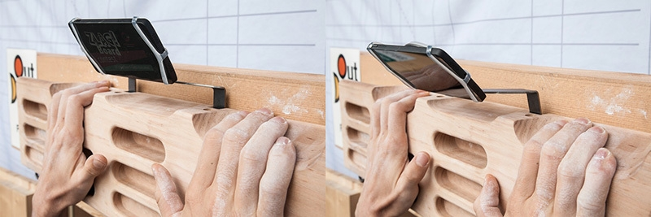
What is a zlagboard?
A hangboard is a training device employed by climbers to enhance finger strength.
The Zlagboard, a specific hangboard created by the company Vertical Life, includes a feature allowing for the attachment of a mobile phone on its top.
When a climber applies weight to the Zlagboard, the mobile phone tilts, resulting in a change in rotation speed as detected by its accelerometer. This data can be utilized to assist users in their exercise routine and to monitor their training progress.

Slide 3
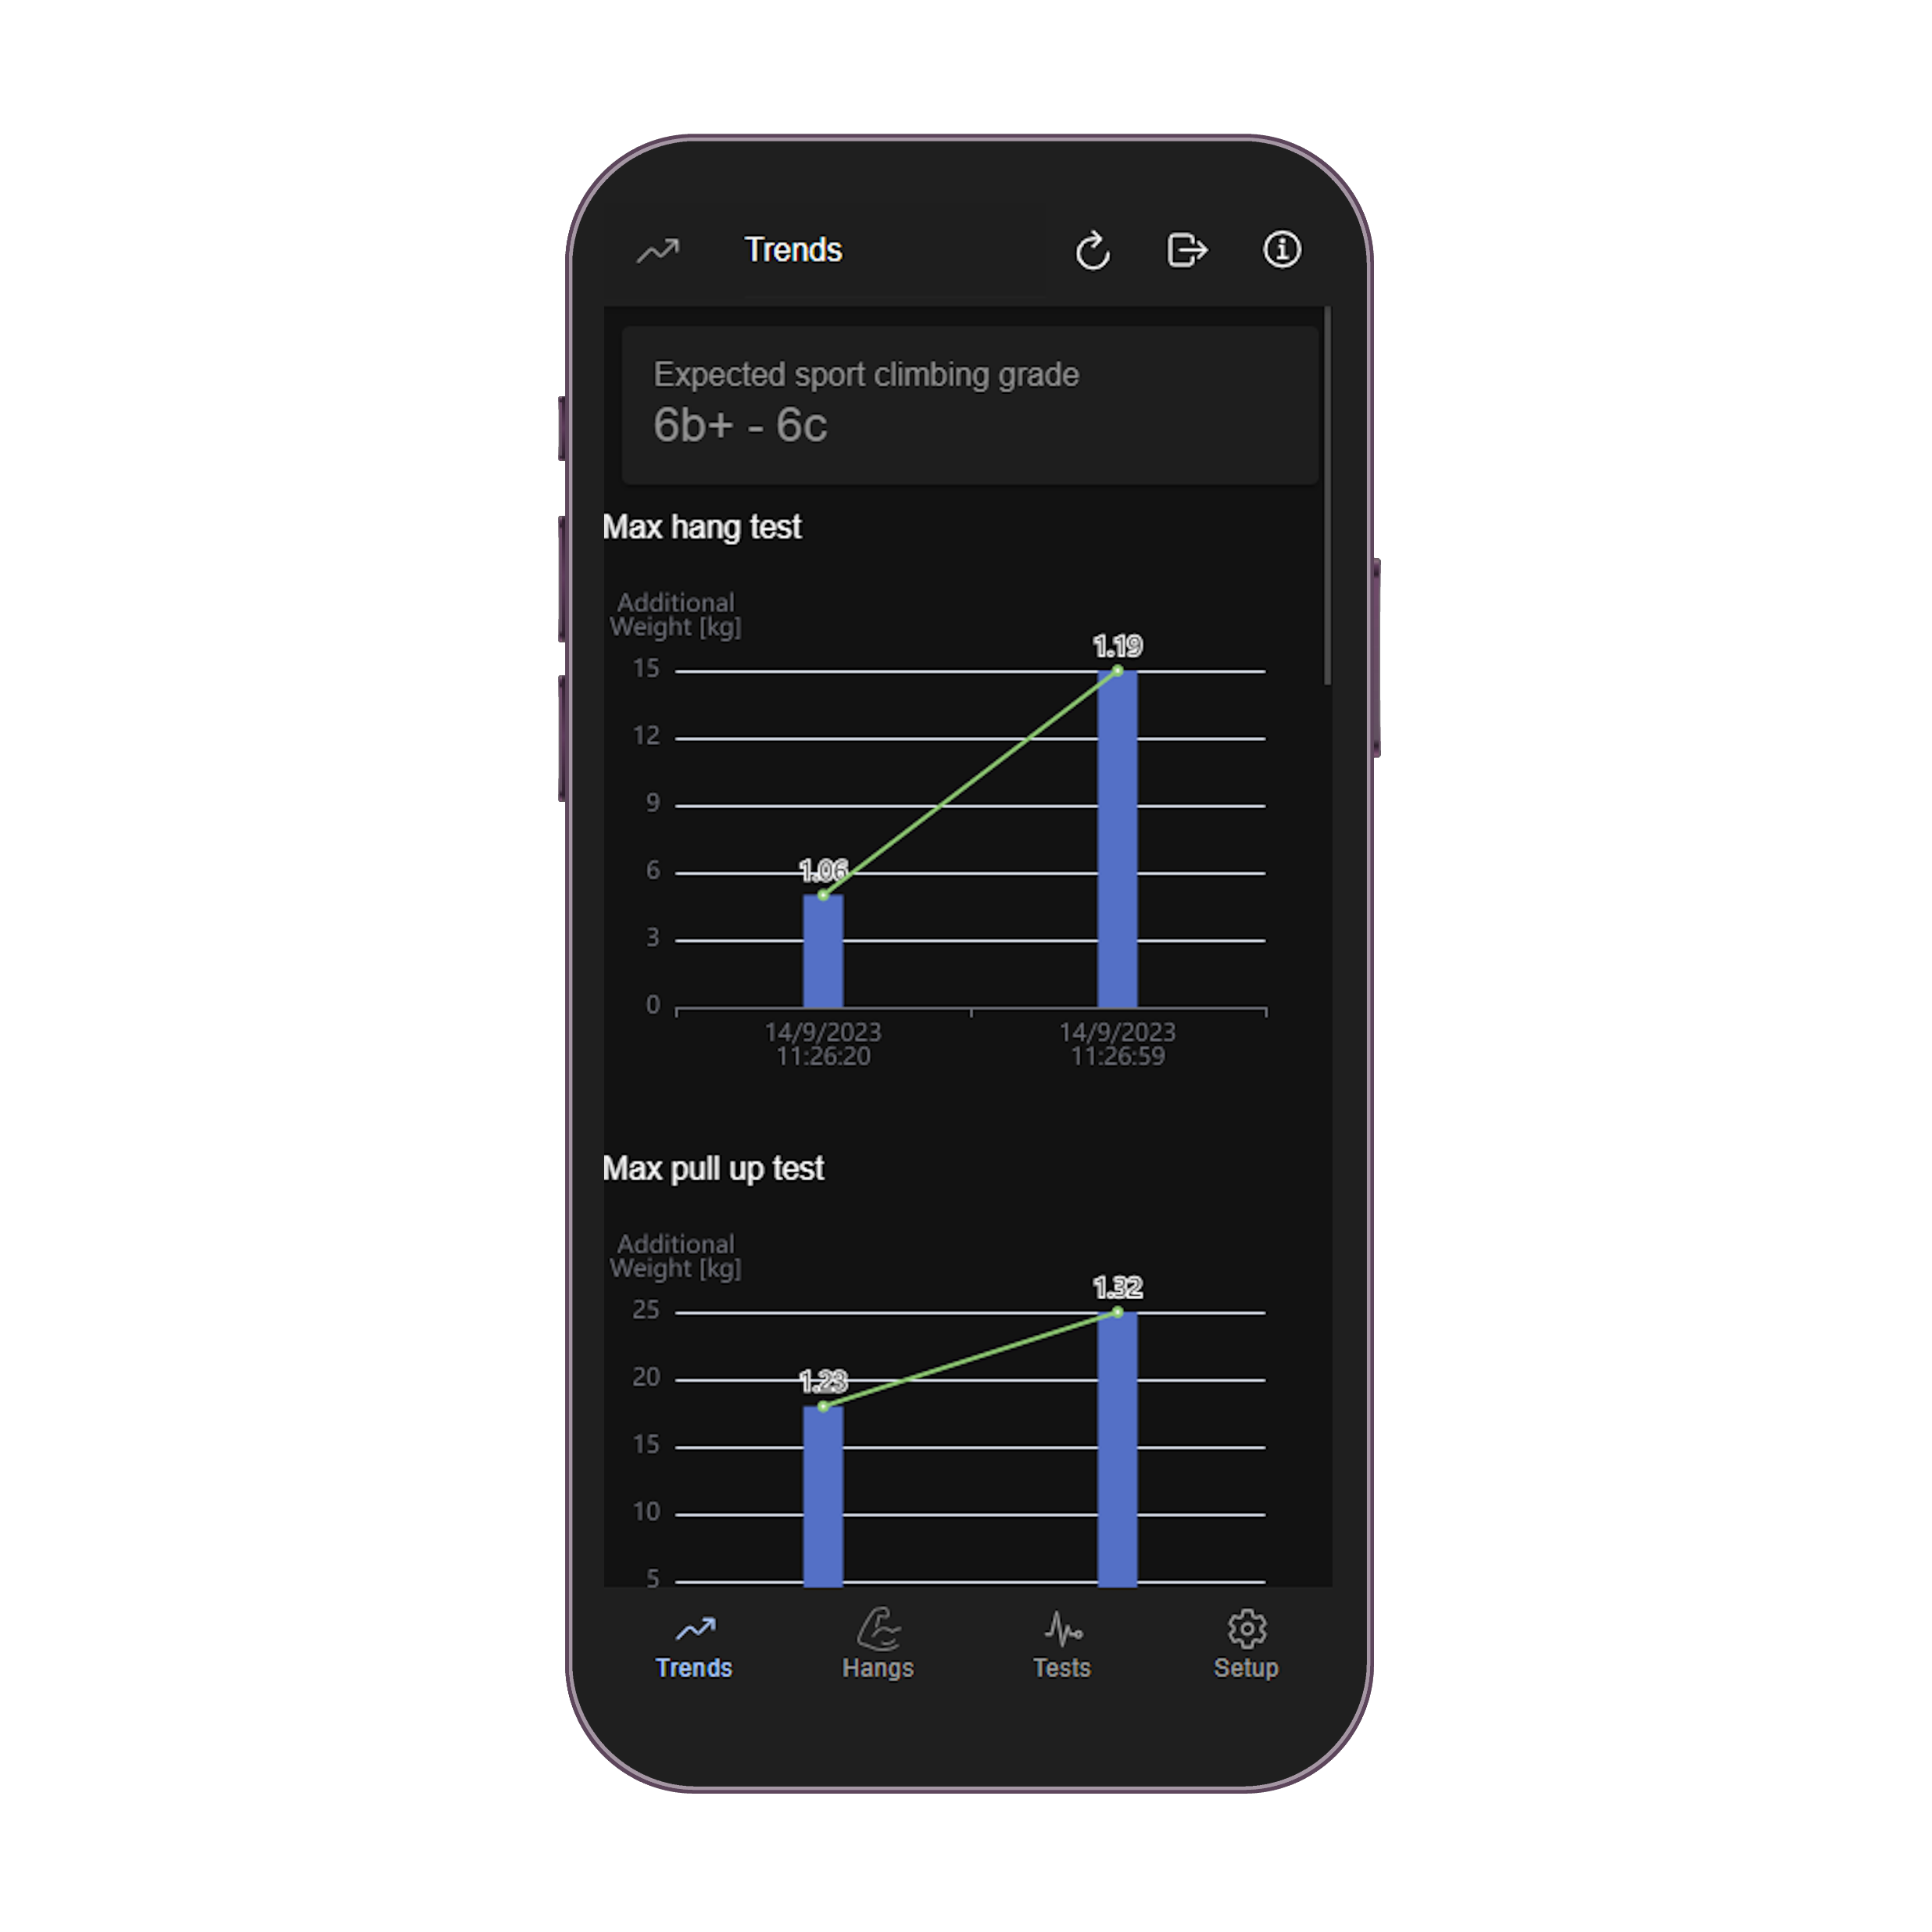
What is a ZlagTrack?
ZlagTrack is a mobile application designed to assist climbers in tracking their training progress on a Zlagboard.
ZlagTrack records hang results, including hang duration, added weight, and holds configuration.
By conducting fitness assessment tests, ZlagTrack can provide climbers with an estimate of their anticipated sport climbing grade level based on statistical data

Slide 4
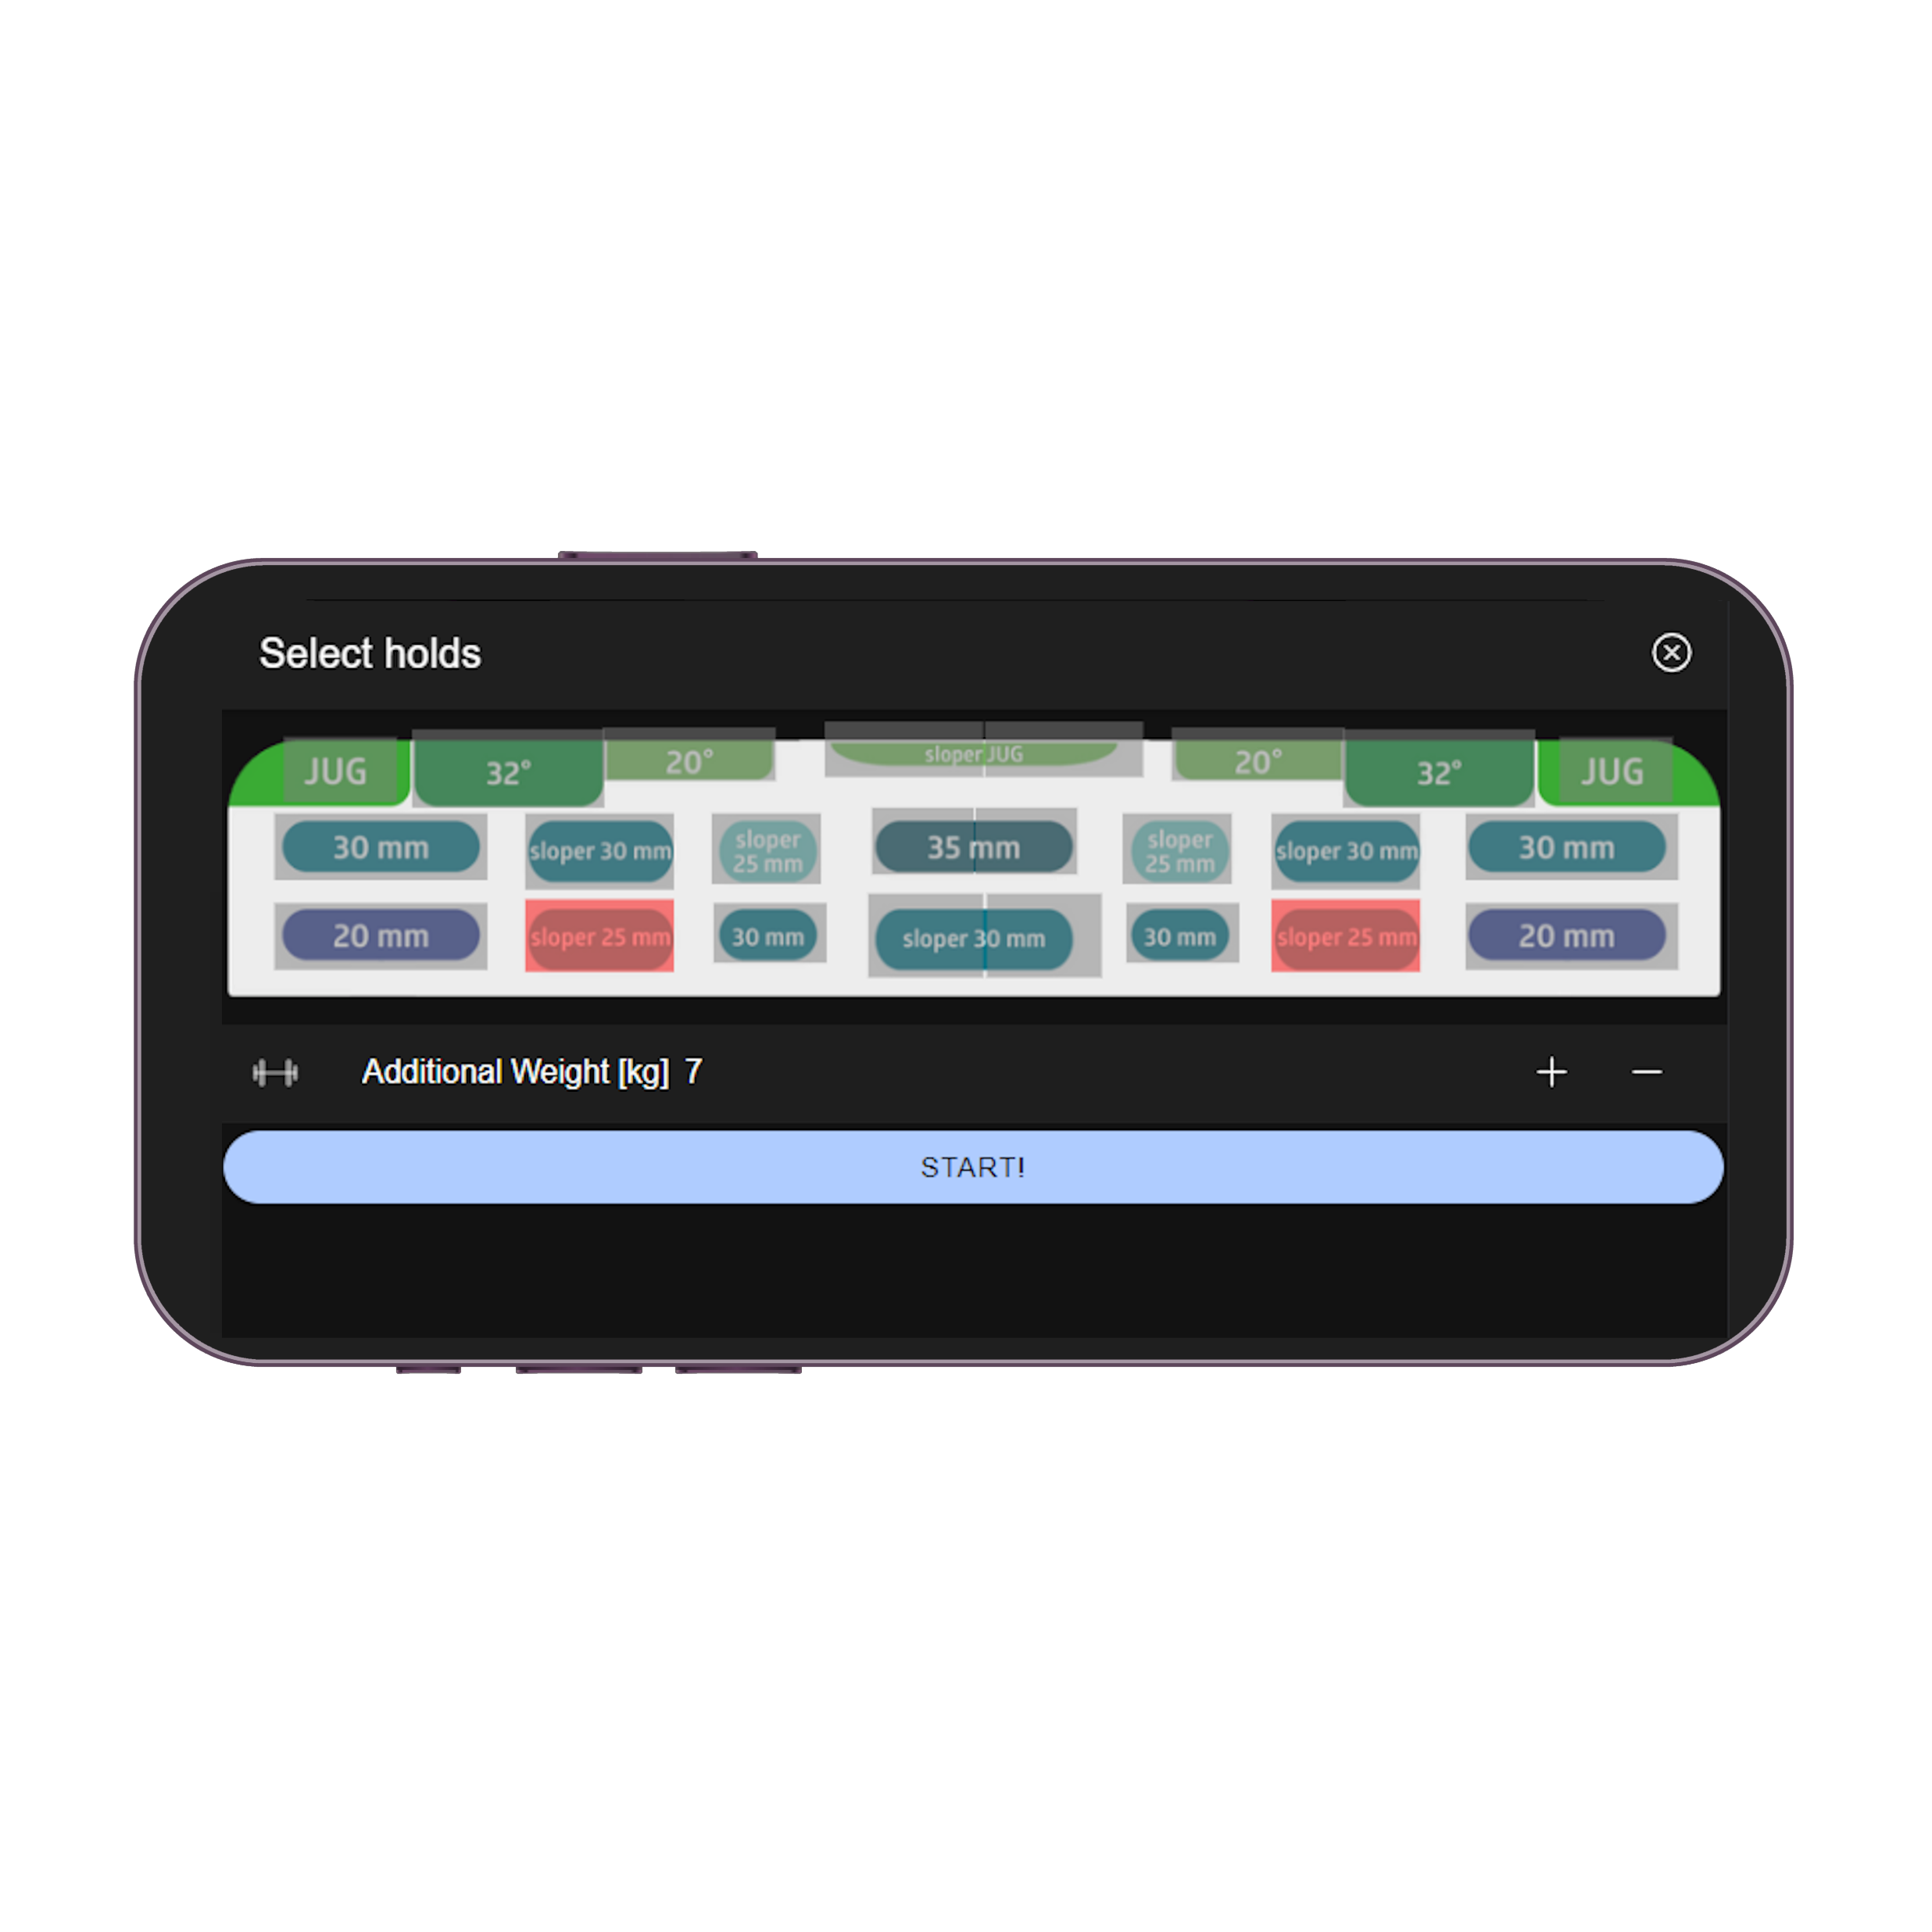
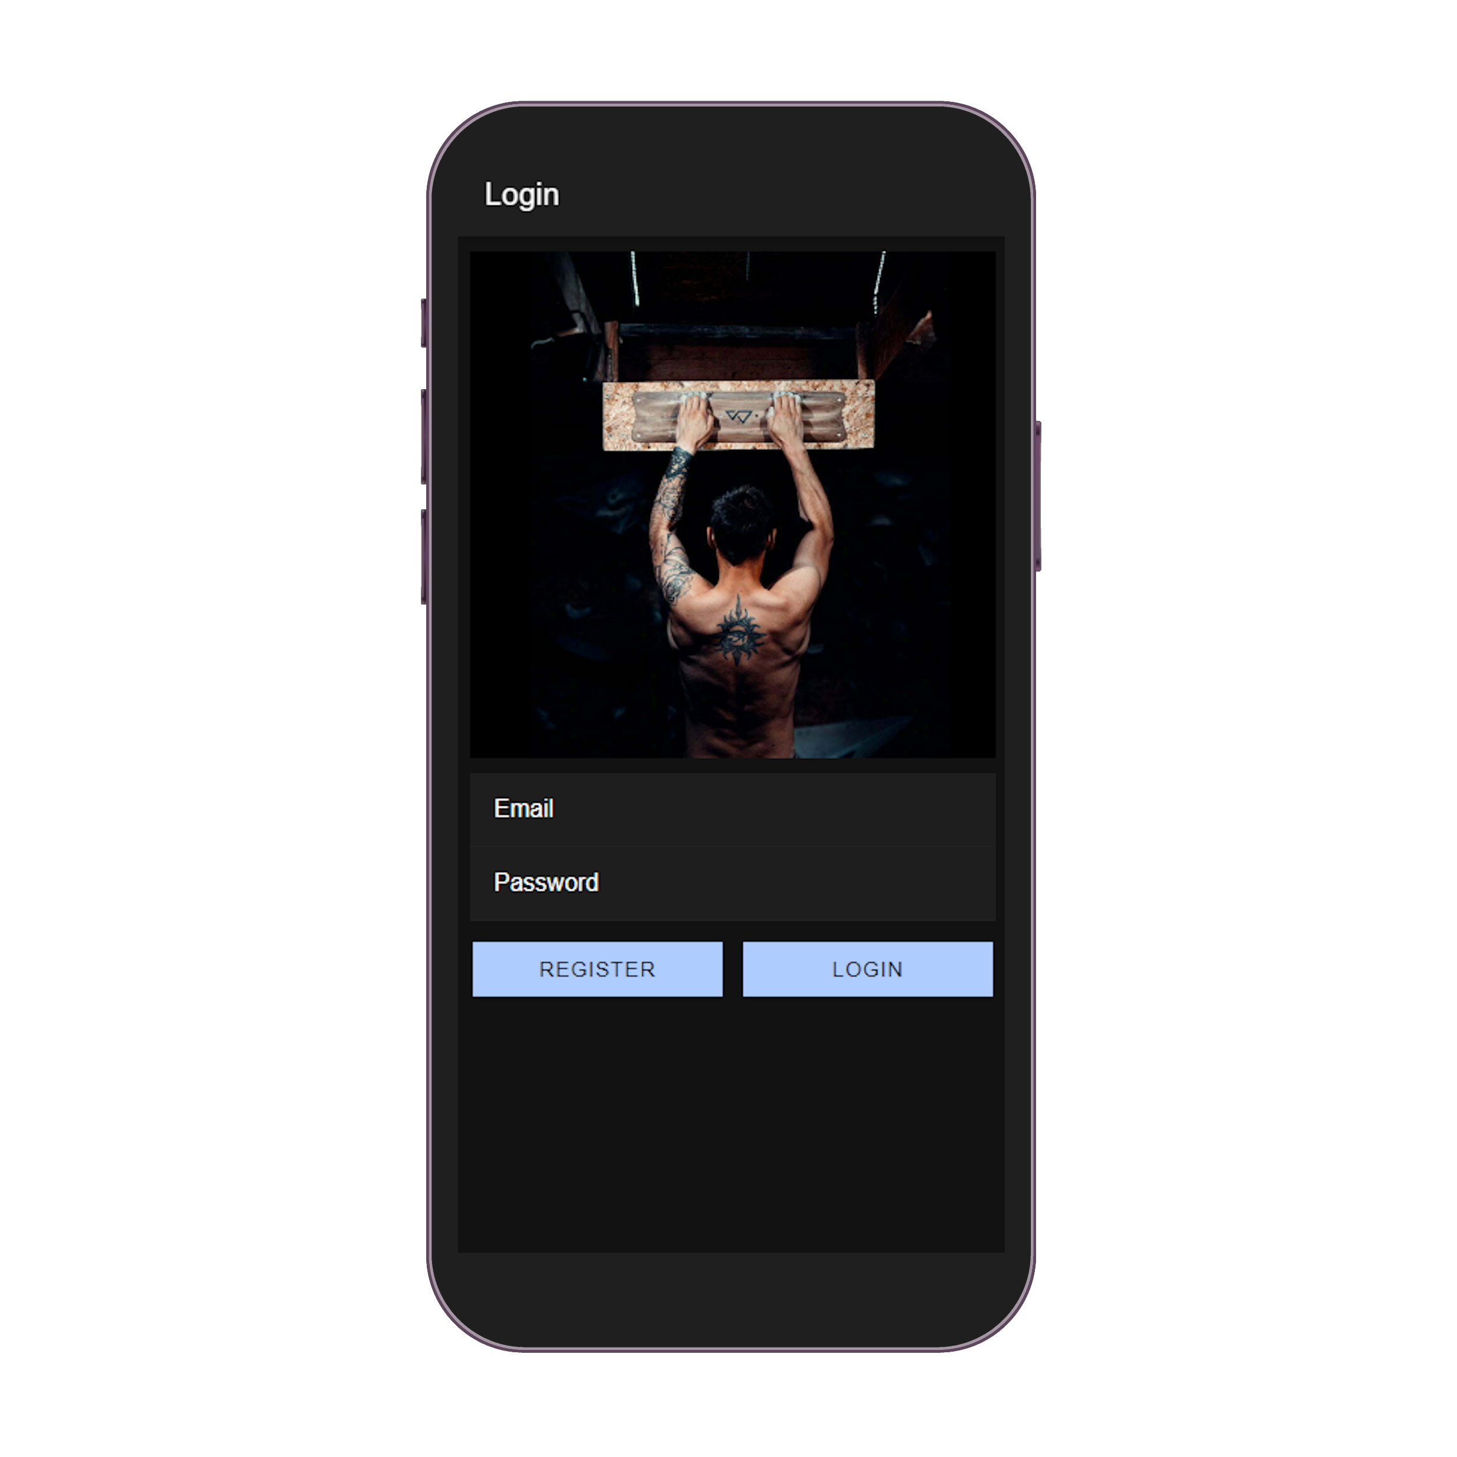
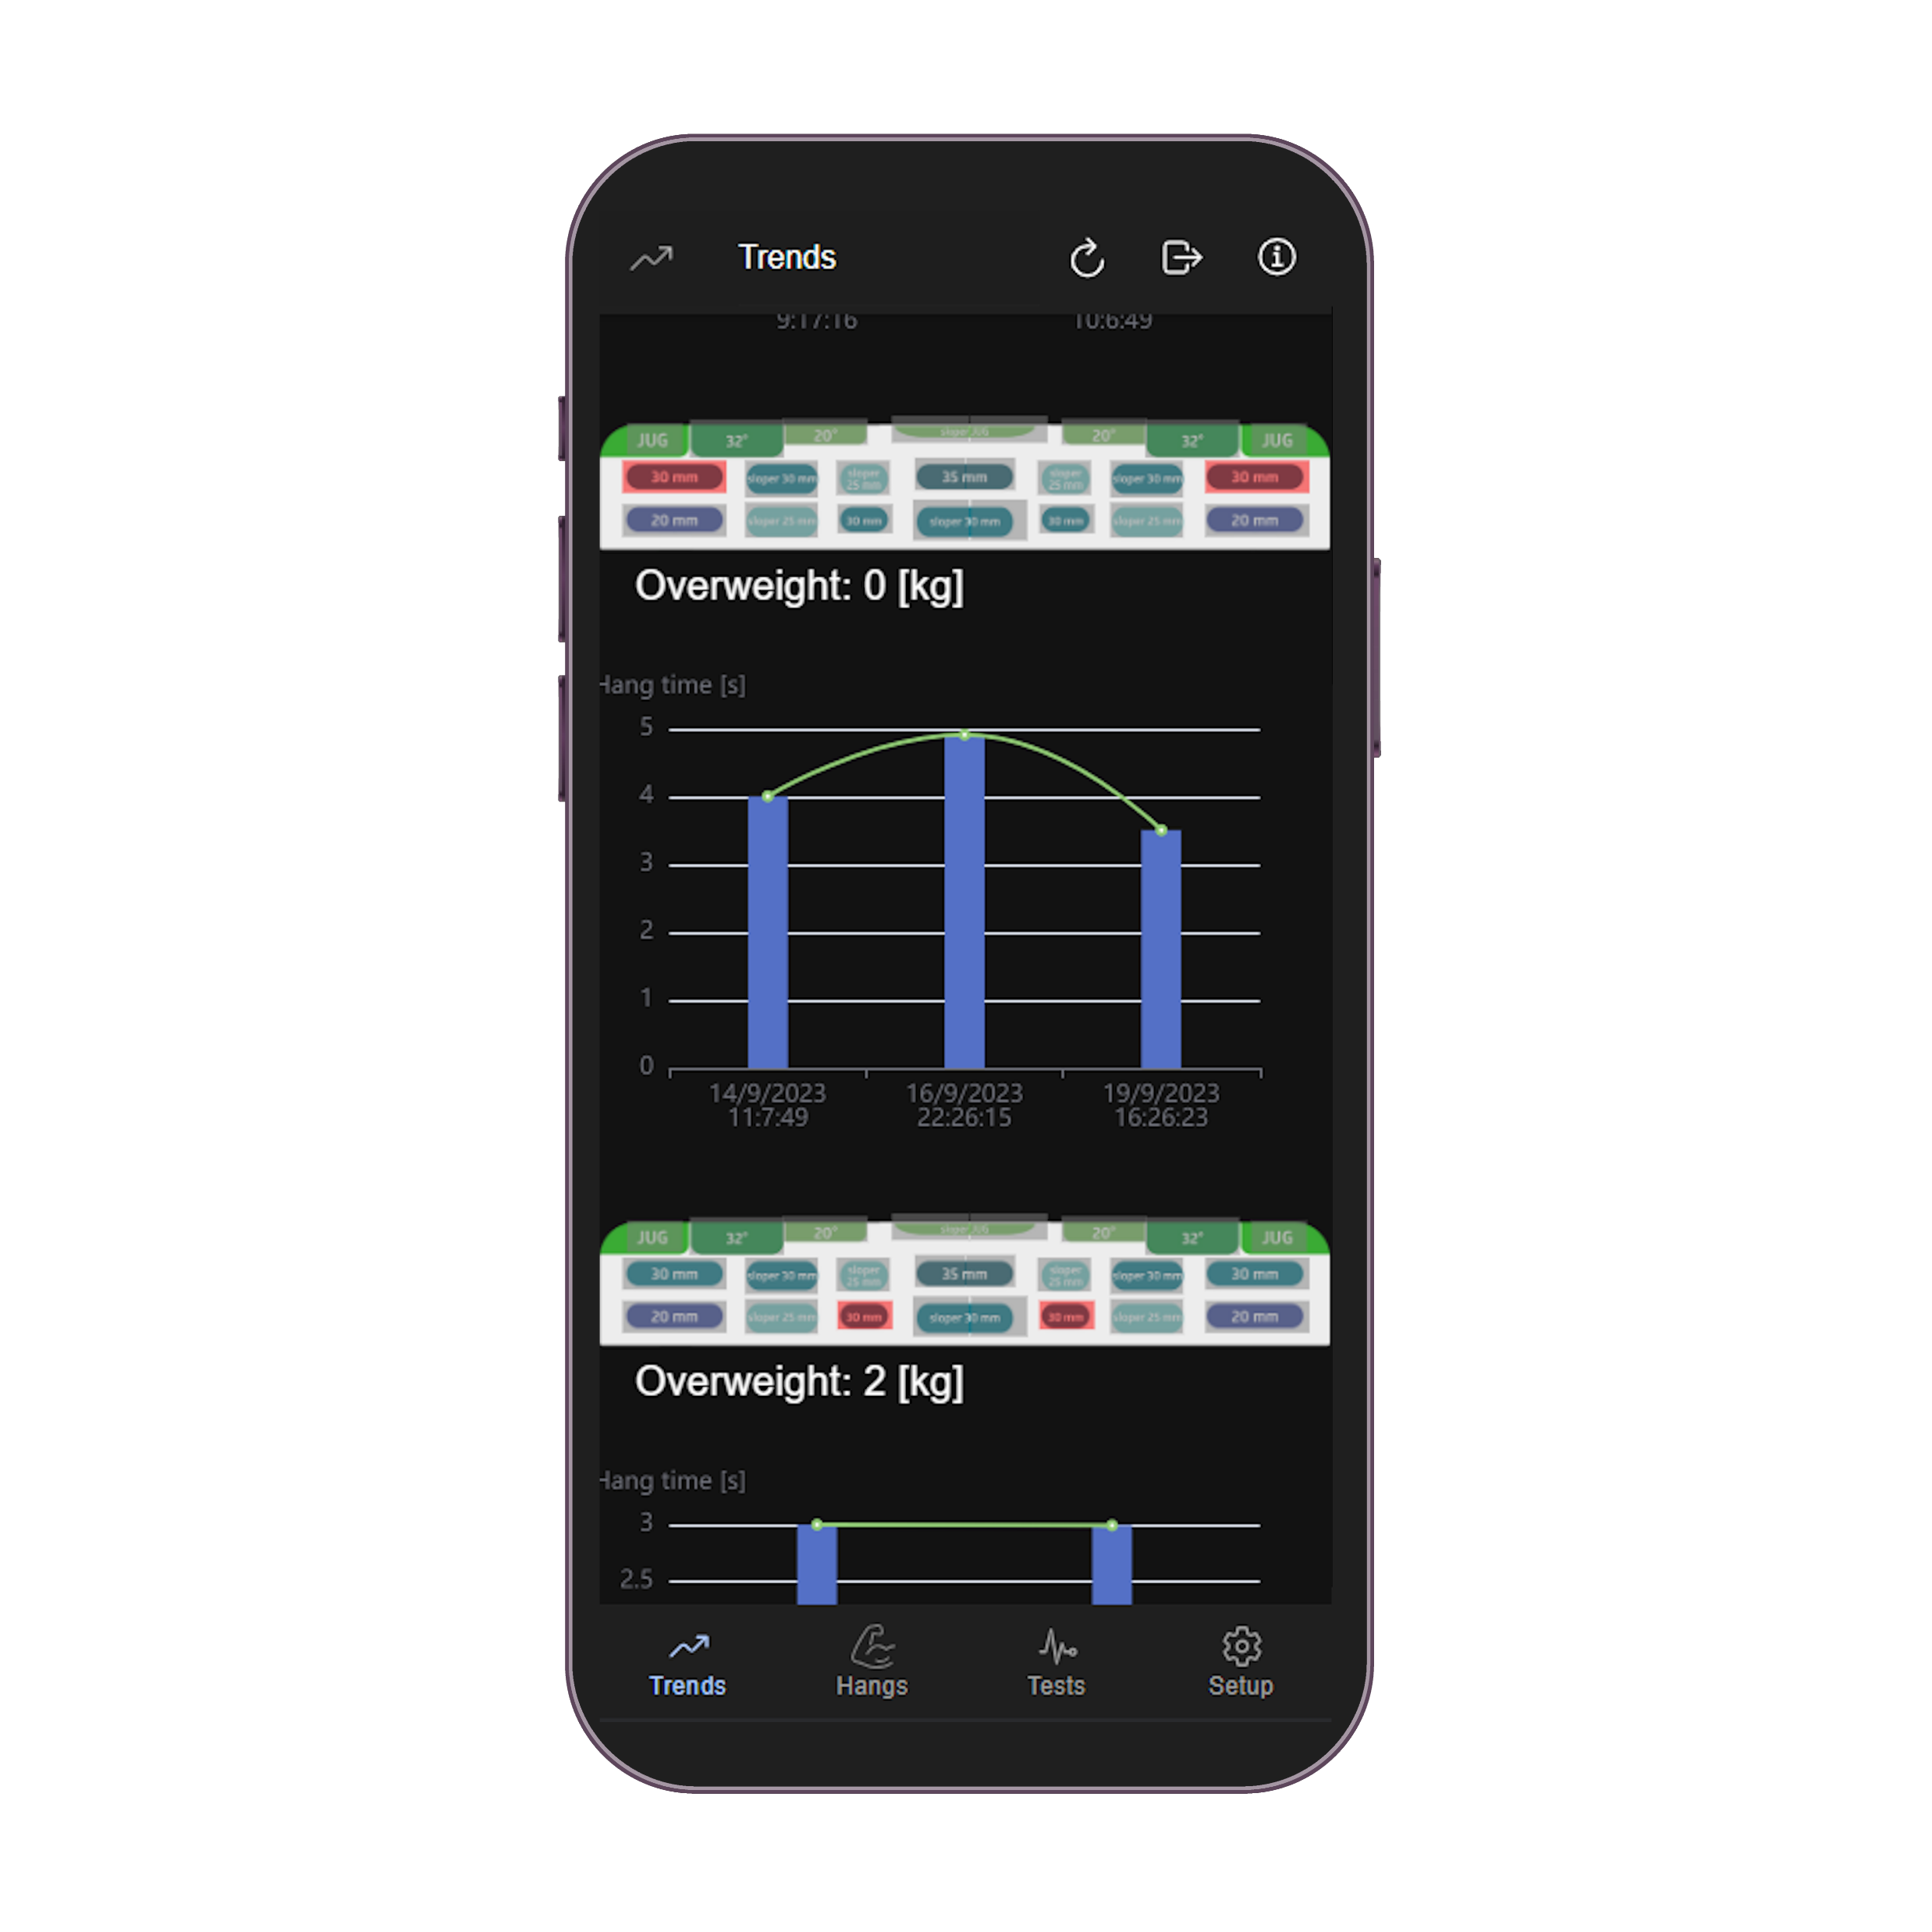
How does hangs tracking work?
2
1
3
Login to your account
Select the holds and overweight for you hang
Save and analyze the results

Slide 5
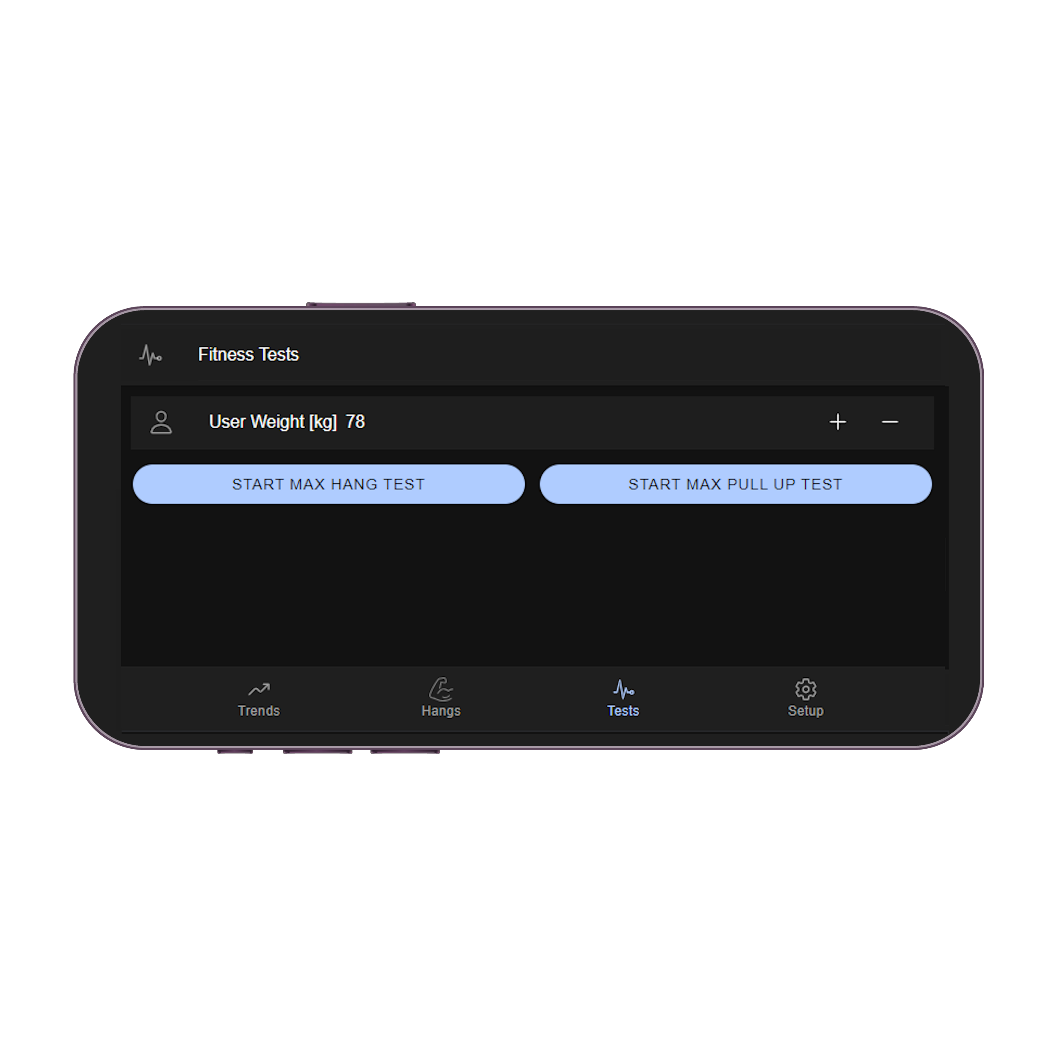
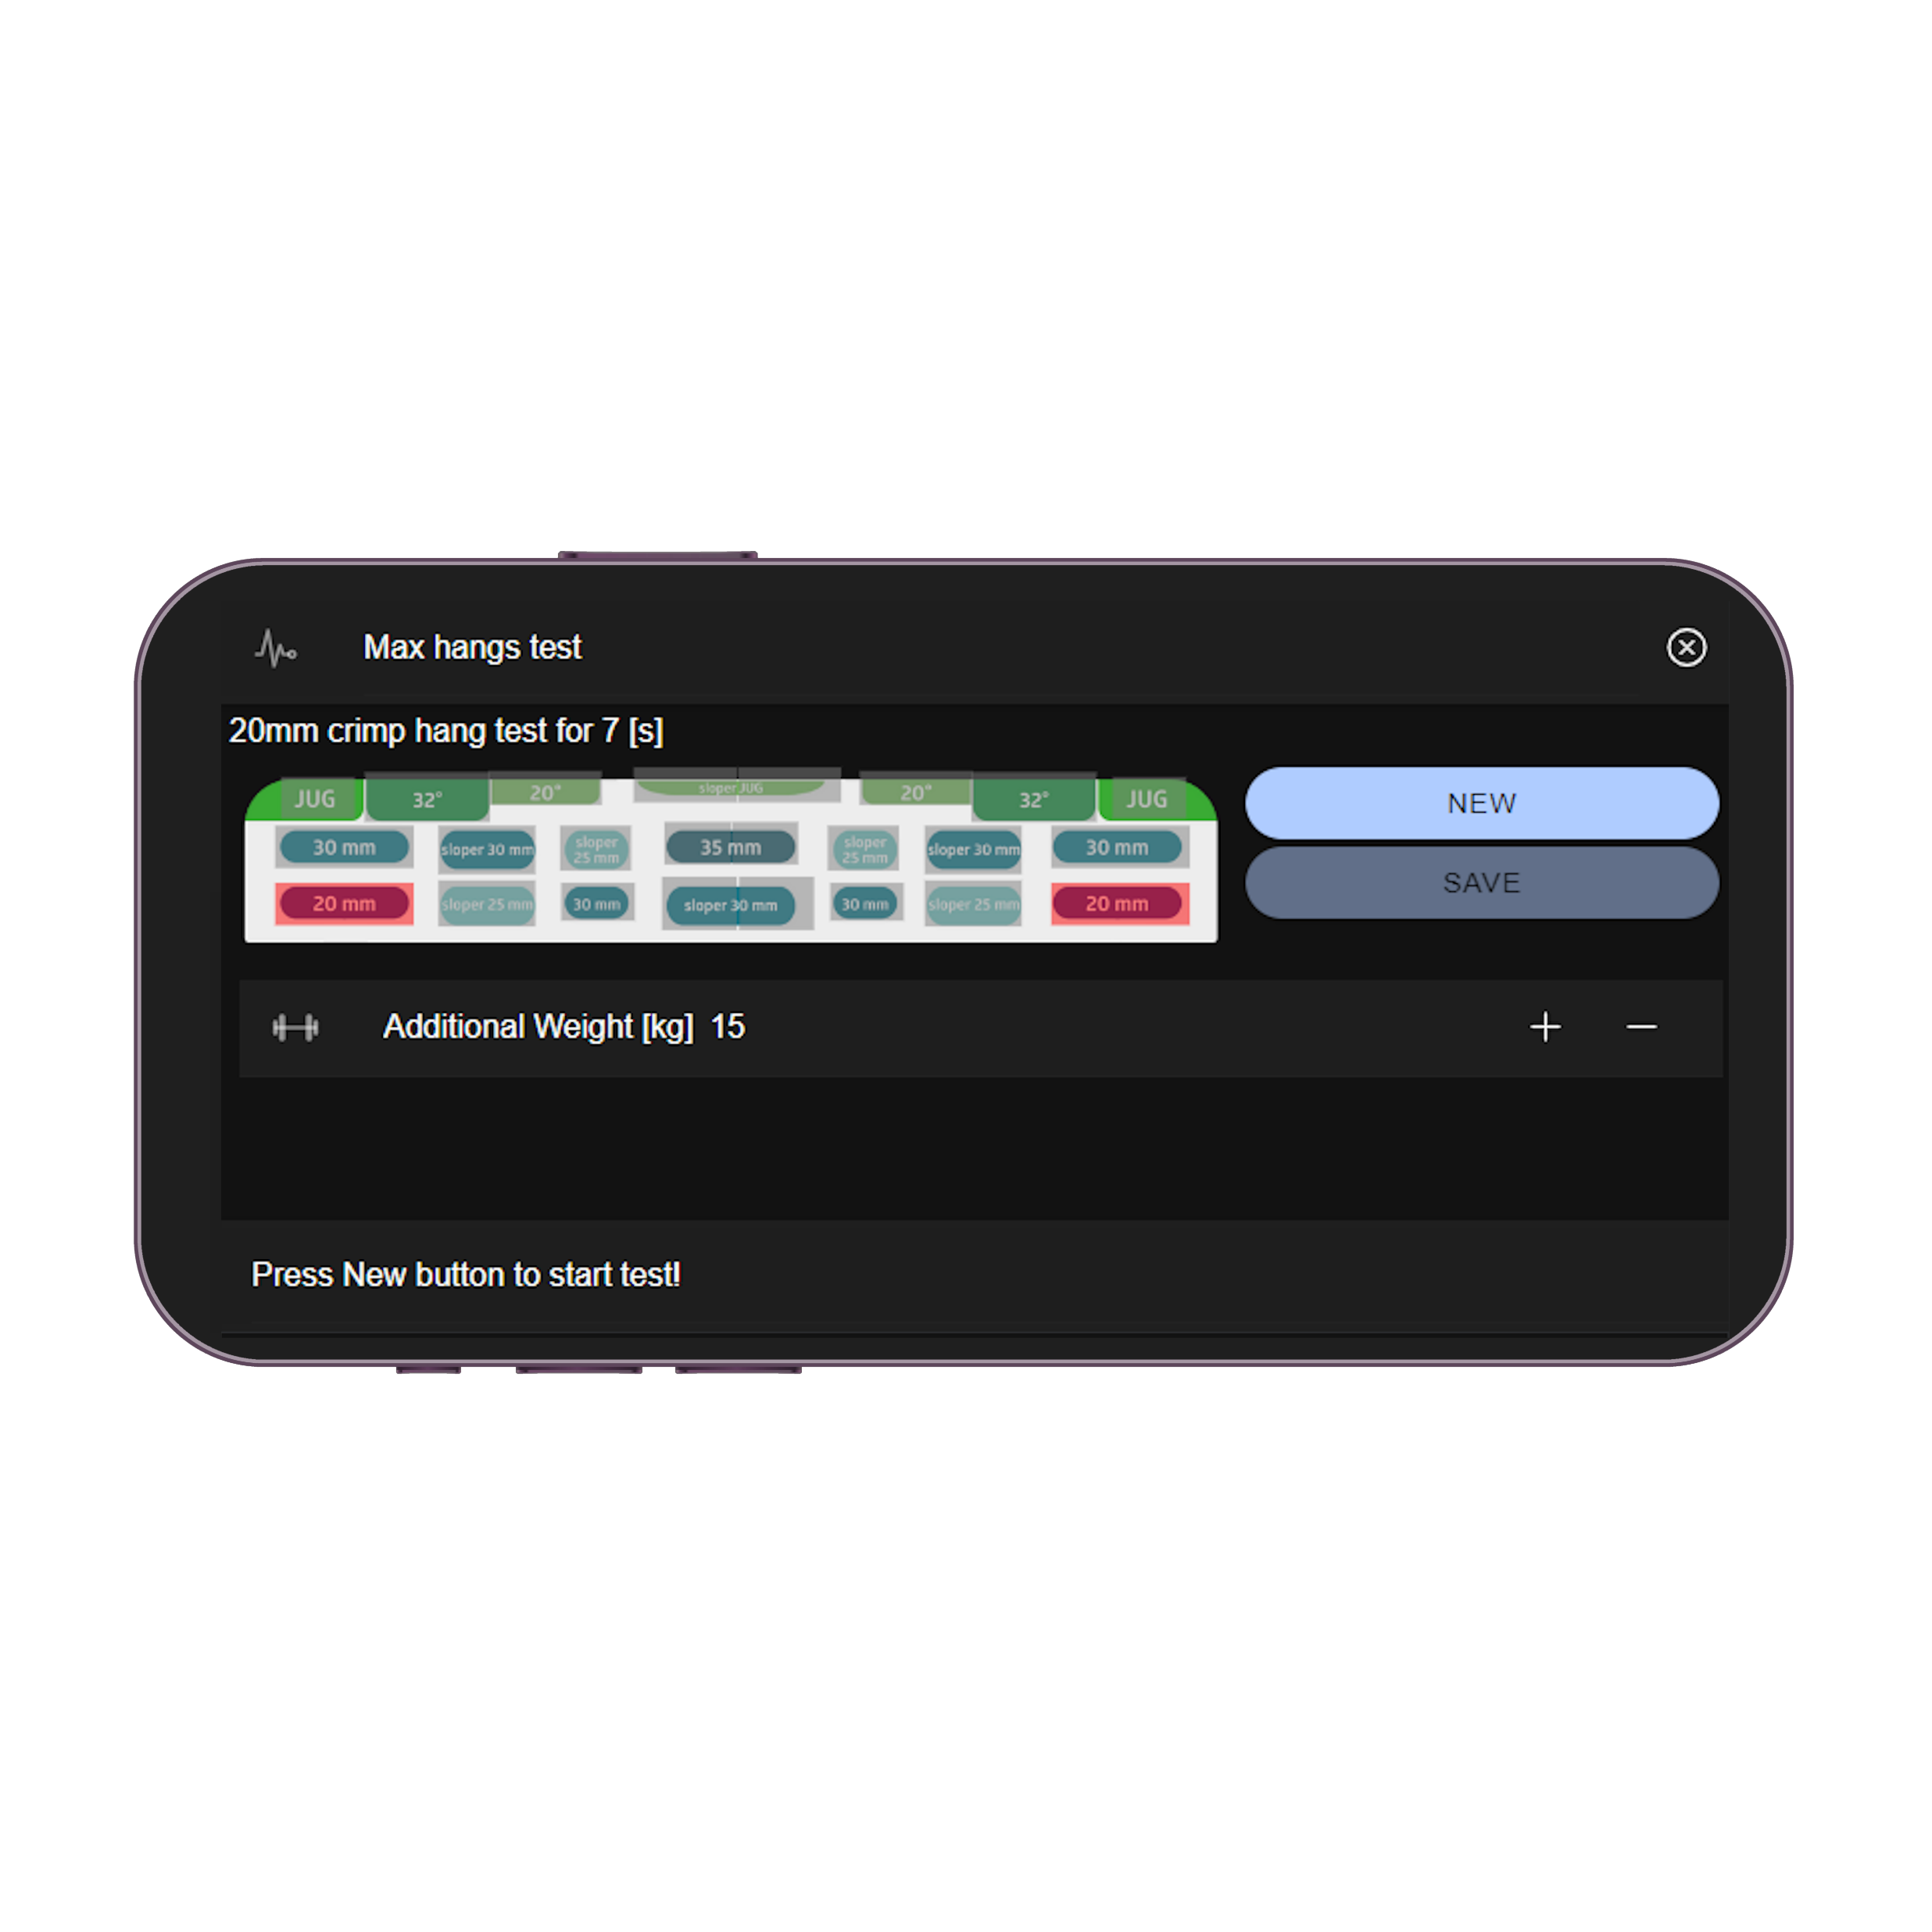
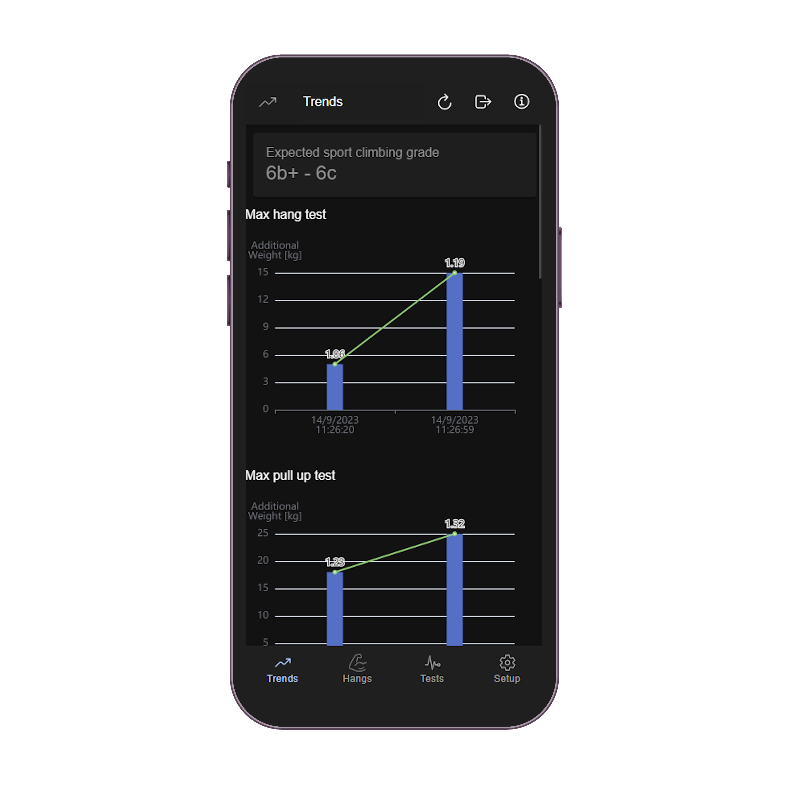
How do fitness assessment tests work?
3
1
2
Select the assessment type
Perform the test following instructions
ZlagTrack will calculate you Weight to Strength ratio and estimate you climbing level

Slide 6




Tech stack
Back end
Authentication and Database
Firebase + Firestore
Front end
Cross platform app (iOS, Android)
Angular + Ionic + Capacitor

